Slide 1



Solana PROFESSIONAL EDUCATION
SOLANA FOUNDATION
MIKE MACCANA
Notes:
INSTRUCTOR: Remember to slow down when giving the presentation! Keep this slide on while greeting students
Show them where breakfast is, bathrooms, etc.

Slide 2
SETUP CHECK
Notes:
Ask students:
WSL2 and Windows Terminal
node.js 18 or 20
(Solana CLI tools aren't necessary at this point)

Slide 3
SETUP CHECK
macOS, Linux, Windows laptop
Windows must have WSL2 and Windows Terminal
nodejs 18 or 20
node --version
In person: Telegram for desktop
(we'll use this to send our wallet
addresses to each other)
Notes:
Ask students:
WSL2 and Windows Terminal
node.js 18 or 20
(Solana CLI tools aren't necessary at this point) NOTE: if a student has trouble during setup, ask the other students to do intros while the student sets up.

Slide 4
INTRODUCTIONS
Notes:
Ask students:
their name
where they work / study
why they’re interested in blockchain, or any experience
STUDENTS GO FIRST! Pick a student to start.

Slide 5


CRYPTO
Notes:
Crypto starts with cryptography

Slide 6

LESSON 1: INTRODUCTION TO
CRYPTO
GRAPHY

Slide 7
SYMMETRIC CRYPTO
Notes:
Cryptography started in ancient Egypt, 5-7000 years ago!
The earliest crypto was was we now call "symmetric cryptography".

Slide 8
SENDER AND RECIPIENT
DECIDE a secret

Slide 9
SENDER AND RECIPIENT
DECIDE a secret
sender encrypts
USING THE secret

Slide 10
SENDER AND RECIPIENT
DECIDE a secret
sender encrypts
USING THE secret
RECIPIENT DECRYPTS
USING THE SAME SECRET
Notes:
Examples of symmetric cryptography: Mary Queen of Scots in the tower of London - sent messages to her guards using a symmetric cipher
The Axis powers in WW2 with the enigma machine

Slide 11
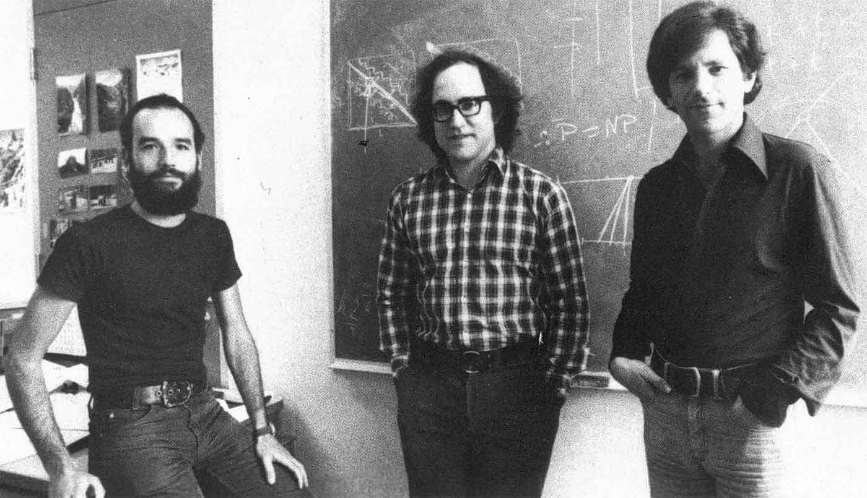
DISK ENCRYPTION
SYMMETRIC ENCRYPTION EXAMPLE:

Slide 12
ASYMMETRIC CRYPTO
Notes:
Symmetric cryptography was all of cryptography until the 1970s, when asymmetric cryptography was introduced by these 3 gentlemen: Rivest, Shamir, Adleman
Also Clifford Cocks in the UK!

Slide 13
Sender and recipient
EACH have a keypair:
A public key
they can show to everyone
A private key
WHICH IS kepT secret

Slide 14
ASYMMETRIC
ENCRYPTION
SENDER ENCRYPTS DATA
WITH RECIPIENT’S PUBLIC KEY
RECIPIENT DECRYPTS DATA,
USING THEIR PRIVATE KEY.

Slide 15
ASYMMETRIC ENCRYPTION EXAMPLE:
WEBSITES
Notes:
Also the chat app in your wallet!
Also the HDCP used for this presentation! There’s a public key used by the projector.

Slide 16
SIGNING
SIGNER ENCRYPTS SOME DATA
WITH THEIR OWN PRIVATE KEY.
ANYONE CAN USE THE
SIGNER’S PUBLIC KEY to
PROVE THE SIGNER SIGNED IT
Notes:
Asymmetric crypto also created digital signatures, and that's the most important part of Solana today.
Signatures allow systems to prove someone did something.

Slide 17
ASYMMETRIC SIGNING EXAMPLE:
PASSPORTS

Slide 18
ASYMMETRIC SIGNING EXAMPLE:
PASSPORTS
ALSO SOLANA TRANSACTIONS!
Notes:
Also SSH! There’s usually a public key installed on servers you SSH into.

Slide 19
LAB
LOADING AND SAVING KEYPAIRS

Slide 20
1. Make a new project
mkdir solana-training
cd solana-training
git init .
npm init -y
npm i @solana/web3.js @solana-developers/helpers esrun
Notes:
Make a new directory, install TypeScript, Solana web3.js and esrun:

Slide 21
2. Make a keypair
generate-keypair.ts
import { Keypair } from "@solana/web3.js";
const keypair = Keypair.generate();
console.log(`✅ Generated keypair!`)
npx esrun generate-keypair.ts
Notes:
Make a new file called generate-keypair.ts
Then run it with esrun.
To make the ✅ emoji: on Mac: ctrl + command + space Windows: win + .

Slide 22
3. Inspect the public and private key
generate-keypair.ts (updated)
import { Keypair } from "@solana/web3.js";
const keypair = Keypair.generate();
console.log(`The public key is: `, keypair.publicKey.toBase58());
console.log(`The secret key is: `, keypair.secretKey);
console.log(`✅ Finished!`);
npx esrun generate-keypair.ts
Notes:
Update the file and run it again.

Slide 23
4. Make an .env file
.env
SECRET_KEY="[
128, 166, 168, 193, 245, 44, 59, 104, 191, 31,
234, 44, 94, 240, 73, 226, 167, 218, 120, 123,
100, 217, 143, 131, 240, 117, 3, 133, 104, 97,
221, 192, 63, 247, 49, 204, 178, 219, 103, 184,
240, 179, 100, 205, 229, 87, 193, 135, 159, 117,
114, 238, 250, 53, 147, 116, 130, 199, 143, 120,
62, 15, 23, 15
]"
Notes:
Update the file and run it again.

Slide 24
5. Load the keypair from the .env file:
npm i dotenv
load-keypair.ts
import "dotenv/config";
import { getKeypairFromEnvironment } from "@solana-developers/helpers";
const keypair = getKeypairFromEnvironment("SECRET_KEY");
console.log(
`✅ Finished! We've loaded our keypair securely, using an env file! Our public key is: ${keypair.publicKey.toBase58()}`
);
npx esrun load-keypair.ts
Notes:
Note how we got the keypair back from the private key - we only need to save the private key!

Slide 25
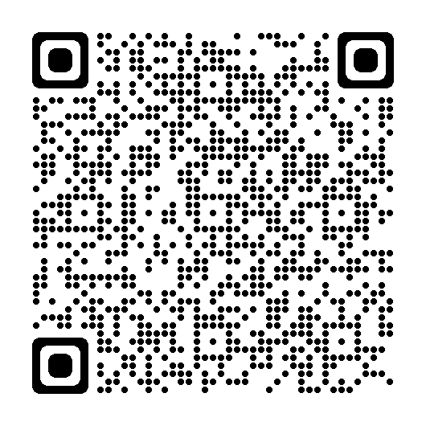
Lesson 1 feedback
Let us know what you think!

Slide 26
LESSON 2: READ DATA FROM
THE NETWORK

Slide 27

Notes:
So how does this relate to Solana?

Slide 28
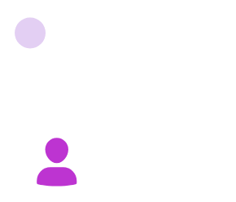
ALICE’S PRIVATE KEY
IS ON HER DEVICE
Notes:
Say we have Alice. And Alice has a keypair.

Slide 29
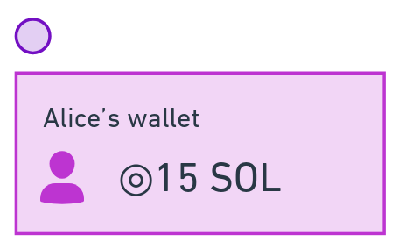
Notes:
In Solana we use the public key as an address.
Alice uses the private key to sign transactions.

Slide 30
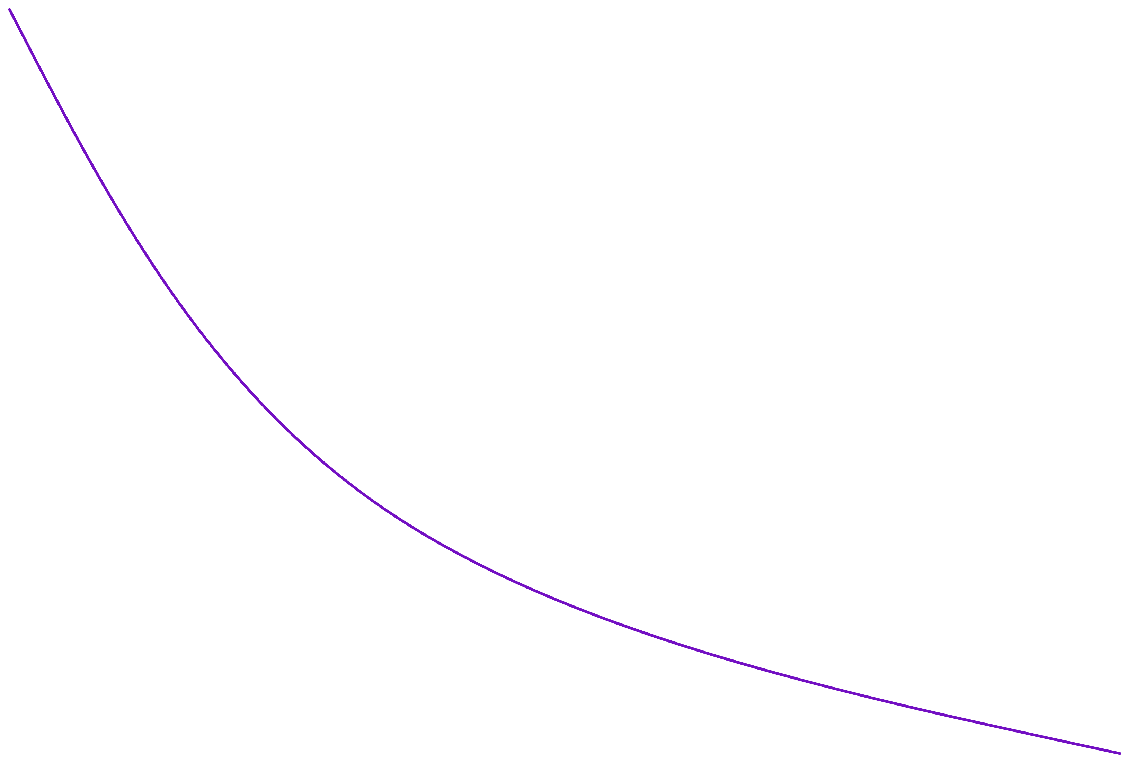
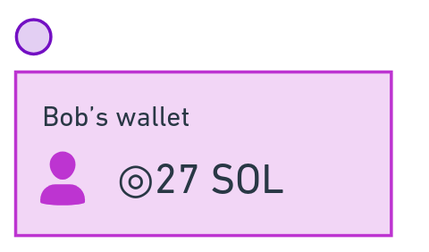
Notes:
Everyone on Solana has at least one keypair, and the pubkey is used as their address

Slide 31
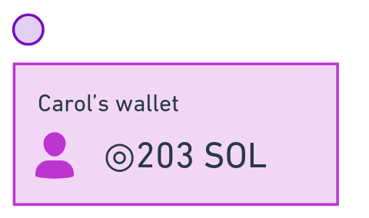
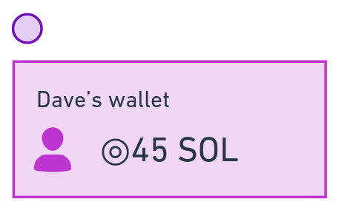
Not overlapping transactions
don't delay each other
ALICE SENDS BOB 10 SOL,
SAYS THANKS
CAROL SENDS DAVE 60 SOL
Notes:
Transactions that don’t overlap can be processed at the same time
This seems obvious, but older blockchains generally wait for transactions to complete in order. This makes them very slow.

Slide 32
Financial Programming 101
Do math in minor units to avoid rounding errors!
Major Units | Minor Units | Decimals
US dollars | Cents | 2
British Pounds (GBP) | Pence | 2
SOL | Lamports | 9
Notes:
Here's something you should know when handling money with computers - whether you're talking about Blockchain or not.
Always do your transactions in minor units to avoid decimal rounding errors.
So do your transaction in cents for USD, pence for GBP, and... lamports for SOL!

Slide 33
Solana has multiple clusters
testnet | The future | Free SOL airdrops
mainnet-beta | Production | No free SOL airdrops
devnet | Shared network for most development purposes | Free SOL airdrops
localnet | localhost validator included with Solana CLI | Free SOL airdrops

Slide 34
LAB
USING SOLANA DEVNET

Slide 35
1. Connect to devnet
check-balance.ts
import "dotenv/config";
import {
Connection,
LAMPORTS_PER_SOL,
PublicKey,
clusterApiUrl,
} from "@solana/web3.js";
const connection = new Connection(clusterApiUrl("devnet"));
console.log(`⚡️ Connected to devnet`);
const publicKey = new PublicKey("YOUR_PUBLIC_KEY_HERE");
Continued on next page...
Notes:
Make a new file called check-balance.ts
We're not going to load the keypair from a file this time, but instead paste in your public key. We'll explain why later.

Slide 36
2. Check the balance
check-balance.ts (continued)
import "dotenv/config";
import {
Connection,
LAMPORTS_PER_SOL,
PublicKey,
clusterApiUrl,
} from "@solana/web3.js";
const connection = new Connection(clusterApiUrl("devnet"));
console.log(`⚡️ Connected to devnet`);
const publicKey = new PublicKey(YOUR_PUBLIC_KEY_HERE);
const balanceInLamports = await connection.getBalance(publicKey);
const balanceInSOL = balanceInLamports / LAMPORTS_PER_SOL;
console.log(
`💰 Finished! The balance for the wallet at address ${publicKey} is ${balanceInSOL}!`
);
npx esrun check-balance.ts
Notes:
Extend the file

Slide 37
3. Airdrop some SOL!
Either use the Solana Faucet:
faucet.solana.com/
import {
getKeypairFromEnvironment,
airdropIfRequired,
} from "@solana-developers/helpers";
...
await airdropIfRequired(
connection,
publicKey,
1 * LAMPORTS_PER_SOL,
0.5 * LAMPORTS_PER_SOL
);
Or the helper function:

Slide 38
3. Check your balance again
npx esrun check-balance.ts
Notes:
Make a new file called generate-keypair.ts
Then run it with esrun

Slide 39
4. Check other people's balances
Join this Telegram group: https://t.me/+ro8_m3J1X7E2NDQ8
Update check-balance.ts to check someone else's balance
Run it again!

Slide 40
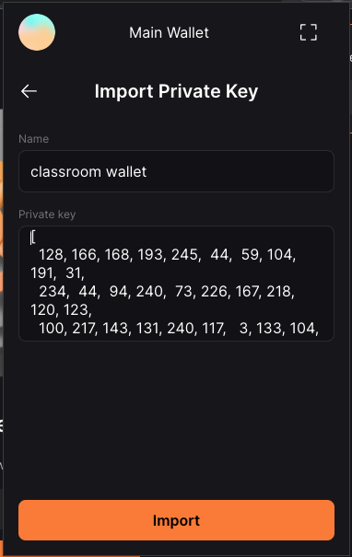
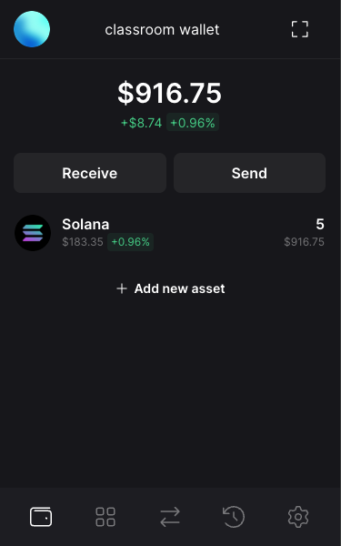
Bonus
Import your key into a wallet app
Add Solflare browser extension and follow normal setup including adding a wallet
Top left icon ⭢ + ⭢ Import Private Key in Solflare
Import your private key from your .env file
Settings ⭢ General ⭢ Network ⭢ DevNet
Notes:
Ask the class if they want to set up a devnet wallet.

Slide 41
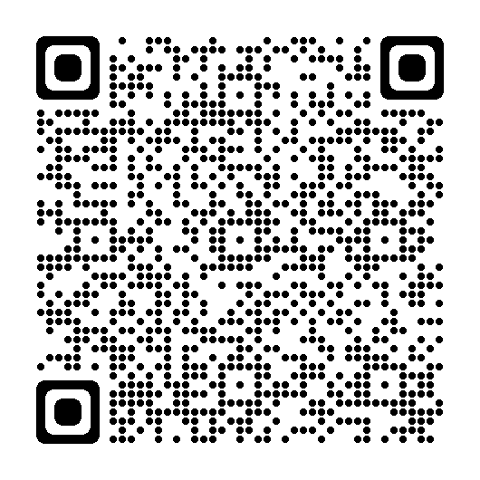
Lesson 2 feedback
Let us know what you think!

Slide 42
LESSON 3: RUN
TRANSACTIONS

Slide 43
Notes:
Back to alice and bob

Slide 44



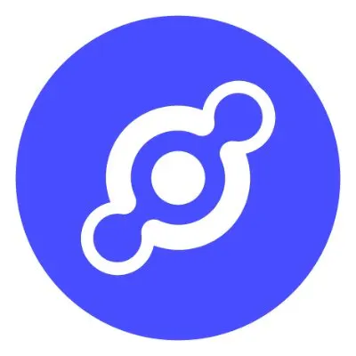









Solana is a
giant global computer
Programs that run on Solana are called onchain programs

Slide 45
Programs that run on Solana are called onchain programs
Notes:
The programs that create tokens, swap tokens, art marketplaces, escrows, market makers, DePIN apps, auctions, retail payments platforms, etc - are called Solana programs.
Called 'Smart Contracts' in older blockchains
https://github.com/solana-labs/explorer/blob/master/app/utils/programs.ts#L107

Slide 46
mv3ekLzLbnVPNxjSKvqBpU3ZeZXPQdEC3bp5MDEBG68
FsJ3A3u2vn5cTVofAjvy6y5kwABJAqYWpe4975bi2epH
metaqbxxUerdq28cj1RbAWkYQm3ybzjb6a8bt518x1s
onchain programs have addresses
9W959DqEETiGZocYWCQPaJ6sBmUzgfxXfqGeTEdp3aQP
EhhTKczWMGQt46ynNeRX1WfeagwwJd7ufHvCDjRxjo5Q
So1endDq2YkqhipRh3WViPa8hdiSpxWy6z3Z6tMCpAo
Notes:
Programs have addresses, too.
A program address itself is just the program, not its data.
Memory on your computer works the same way - programs are separated from data.
Well-known programs are: system, token, token extensions program, metaplex, jupiter

Slide 47
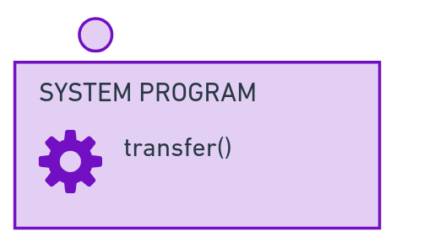

Alice will send Bob 10 SOL
And say thanks!
Notes:
If Alice wants to send Bob 10 SOL, she will:
Use the System program, which has a transfer() function to send SOL Use the Memo program, which has a memo() function to write a small message as part of the transaction

Slide 48
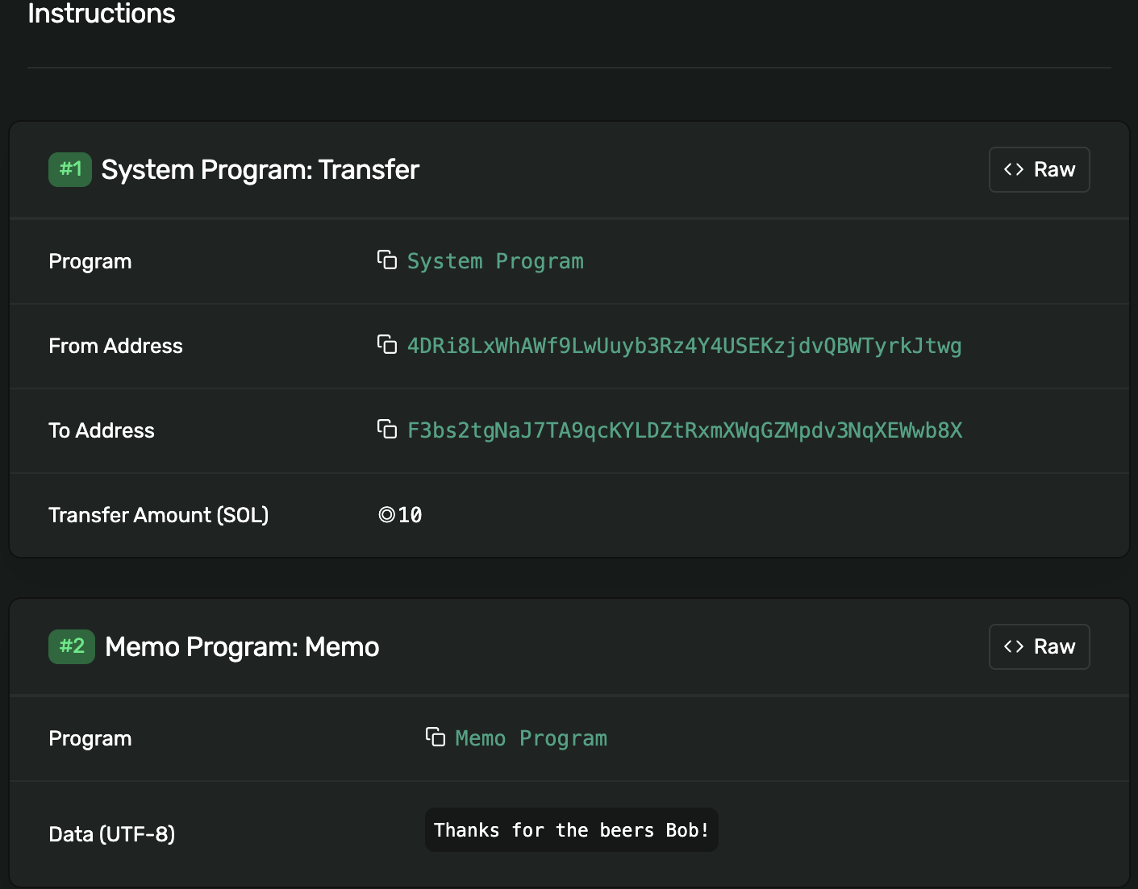
SOLANA EXPLORER
ALICE SENDS BOB 10 SOL,
SAYS THANKS
Alice will send Bob 10 SOL
And say thanks!
Notes:
Here’s the transaction in Solana Explorer - you can see the two instructions inside!

Slide 49
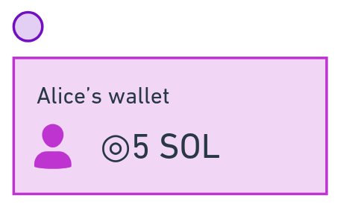

The transaction completes - 10 SOL was transferred from Alice to Bob, and "Thanks!" is written to the logs.
Notes:
If both instructions complete, 10 SOL is now sent to Bob.

Slide 50
LAB
TRANSACTIONS & SENDING SOL

Slide 51
1. Load the keypair and connect to devnet (again!)
send-sol.ts
import "dotenv/config";
import { getKeypairFromEnvironment } from "@solana-developers/helpers";
import {
LAMPORTS_PER_SOL,
PublicKey,
SystemProgram,
Transaction,
clusterApiUrl,
Connection,
sendAndConfirmTransaction
} from "@solana/web3.js";
const sender = getKeypairFromEnvironment("SECRET_KEY");
const connection = new Connection(clusterApiUrl("devnet"));
console.log(
`🔑 Loaded our keypair securely, using an env file! Our public key is: ${sender.publicKey.toBase58()}`
);
Notes:
Make a new file called send-sol.ts

Slide 52
2. Make a transaction, add an instruction to send 0.01 SOL to a classmate, and run it!
send-sol.ts (continued)
... per previous slide ...
const recipient = new PublicKey(SOMEONE_IN_CLASS);
console.log(`💸 Attempting to send 0.01 SOL to ${recipient.toBase58()}...`);
const transaction = new Transaction();
const sendSolInstruction = SystemProgram.transfer({
fromPubkey: sender.publicKey,
toPubkey: recipient,
lamports: 0.01 * LAMPORTS_PER_SOL,
});
transaction.add(sendSolInstruction);
const signature = await sendAndConfirmTransaction(connection, transaction, [
sender,
]);
console.log(`✅ Transaction confirmed, signature: ${signature}!`);
npx esrun send-sol.ts
Notes:
Extend the file

Slide 53
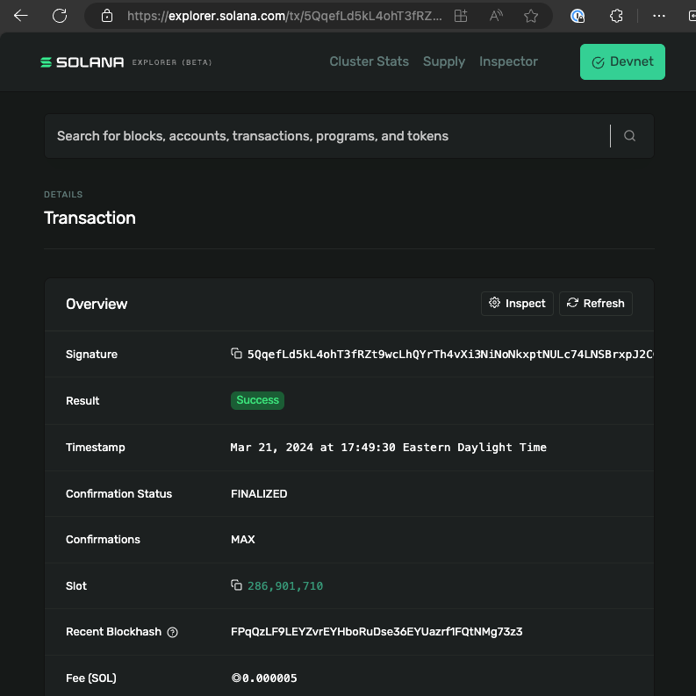
3. Check Solana Explorer
Remember we are using the devnet network.

Slide 54
4. Add a second instruction and run it again!
send-sol.ts (continued)
Add this to your imports:
import { createMemoInstruction } from "@solana/spl-memo";
Add this just after 'transaction.add(sendSolInstruction)'...
const addMemoInstruction = createMemoInstruction("Hello from Solana!");
transaction.add(addMemoInstruction);
console.log(`📝 memo is ${memoText}...`);
npx esrun send-sol.ts
Notes:
Extend the file

Slide 55
5. Check Solana Explorer again
Remember we are using the devnet network.
What were the fees? What is this in USD?

Slide 56
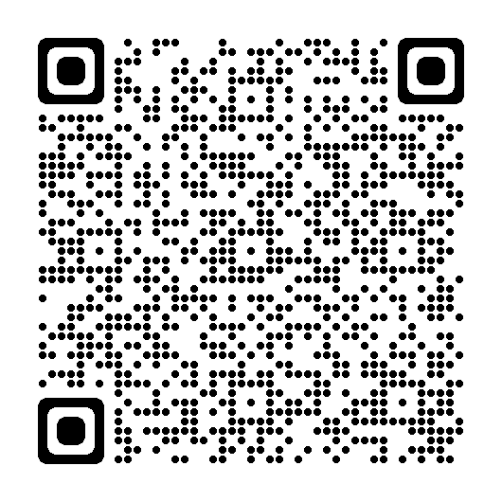
Lesson 3 feedback
Let us know what you think!

Slide 57
LESSON 4: MAKE AND TRANSFER
TOKENS
Notes:
If you get money from family overseas, win a hackathon, or buy snacks at Solana events, you’ll be using USDC rather than SOL.
So what about USDC?

Slide 58
Notes:
Back to Alice and Bob

Slide 59
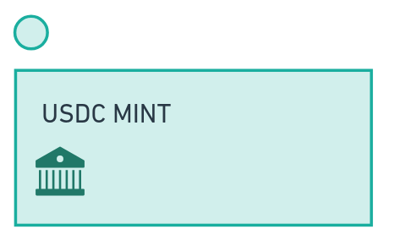
USDC is one one many SPL tokens.
Each token has a unique mint address that
controls the token's supply.
Notes:
Tokens on Solana each have a distinct token mint address, run by the mint authority - the person or organisation that produces the token. The mint is the factory that produces tokens. USDC is produced by Circle, and Circle run the USDC mint at an address they put on their website.

Slide 60
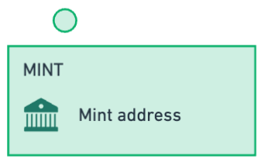

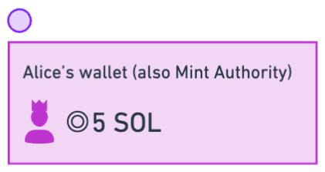
USDC is one one many SPL tokens.
Each token has a unique mint address that
controls the token's supply.
The mint address includes information about the token, including a mint authority - someone allowed to mint new tokens.
Let's mint new tokens and transfer them to Bob!
Notes:
It has a mint authority - someone specified by public key allowed to mint new tokens
It has a freeze authroity - someone specified by public key that can stop new tokens being minted

Slide 61
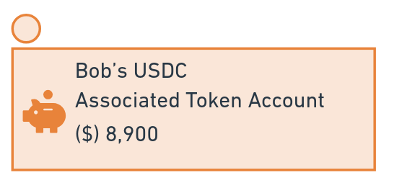
Let's...
Make our own token mint, with our address as the mint authority
Make a PDA for someone to store our tokens
Mint our tokens to their wallet!
A token is uniquely defined by it's mint address
The mint address includes information about the token, including a mint authority - someone allowed to mint new tokens.
Notes:
A token is uniquely defined by it's mint address
It has a mint authority - someone specified by public key allowed to mint new tokens
It has a freeze authroity - someone specified by public key that can stop new tokens being minted

Slide 62
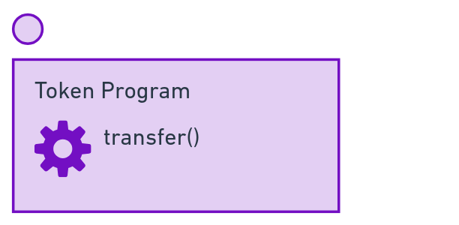
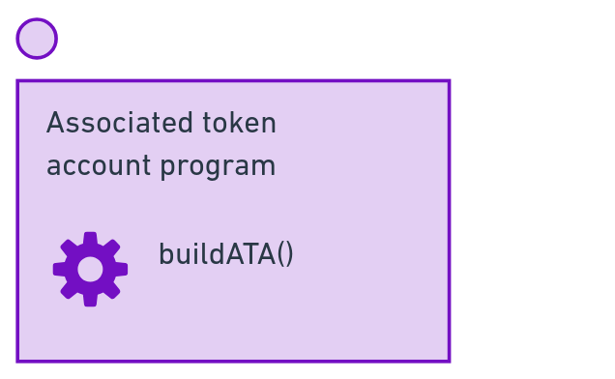

We can transfer SPL tokens just like SOL, except instead of the System Program we use the Token Program to transfer them.
Notes:
Say Alice gets some USDC from Bob.
We can make a transaction with two instructions:
- The associated token program has a buildATA() function. This creates the associated token account if it doesn’t already exist.
- The token account has a transfer() function
Combining those, Alice now has the USDC in account associated with her wallet.

Slide 63
LAB
MAKING A TOKEN MINT,
AND USING IT TO MINT TOKENS

Slide 64
1. Add the @solana/spl-token package
npm i @solana/spl-token

Slide 65
2. Load a keypair and connect
create-token-mint.ts
import { createMint } from "@solana/spl-token";
import "dotenv/config";
import {
getKeypairFromEnvironment,
getExplorerLink,
} from "@solana-developers/helpers";
import { Connection, clusterApiUrl } from "@solana/web3.js";
const connection = new Connection(clusterApiUrl("devnet"));
const sender = getKeypairFromEnvironment("SECRET_KEY");
Continued on next page....
Notes:
Extend the file

Slide 66
3. Make a token mint!
create-token-mint.ts continued
...continued
const tokenMint = await createMint(
connection,
sender,
sender.publicKey,
null,
2
);
const link = getExplorerLink("address", tokenMint.toString(), "devnet");
console.log(`✅ Token Mint: ${link}`);
npx esrun create-token-mint.ts
Notes:
Extend the file

Slide 67
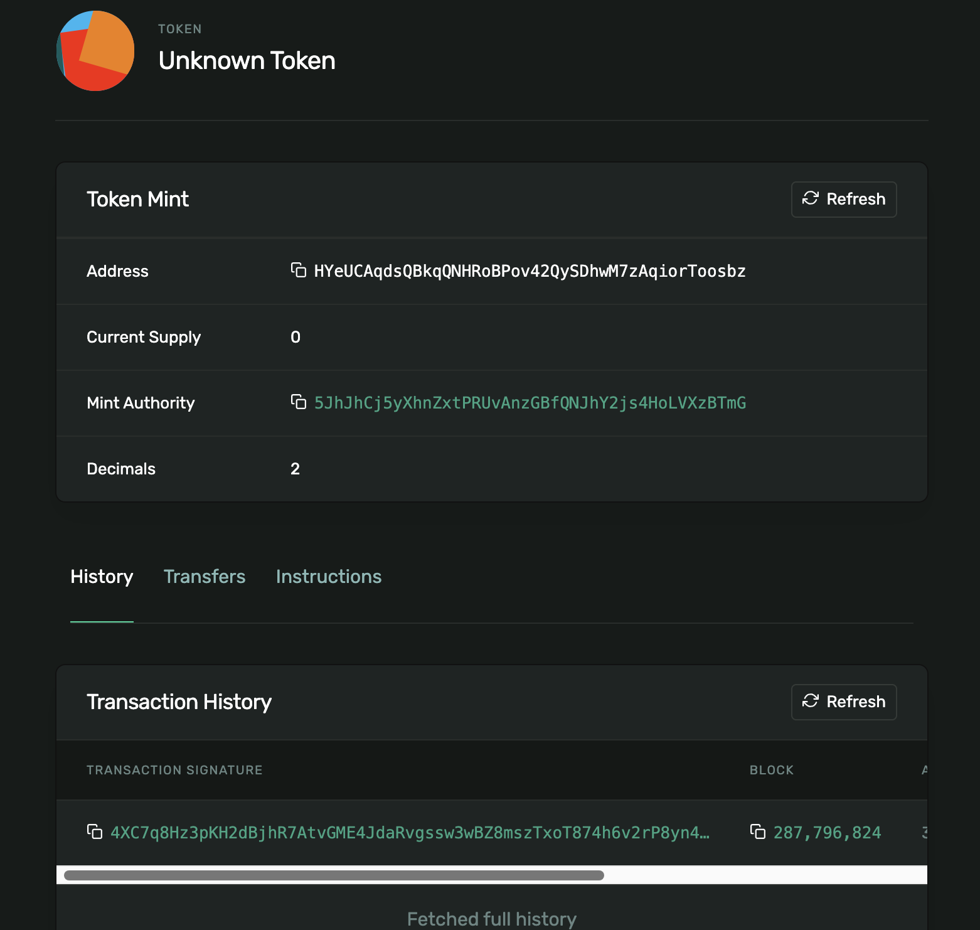
4. Open Solana Explorer
and look at the new Token Mint!

Slide 68
5. Make a token account for a recipient
create-token-account.ts
import { getOrCreateAssociatedTokenAccount } from "@solana/spl-token";
import "dotenv/config";
import {
getExplorerLink,
getKeypairFromEnvironment,
} from "@solana-developers/helpers";
import { Connection, PublicKey, clusterApiUrl } from "@solana/web3.js";
const connection = new Connection(clusterApiUrl("devnet"), "confirmed");
const sender = getKeypairFromEnvironment("SECRET_KEY");
console.log(
`🔑 Loaded our keypair securely, using an env file! Our public key is: ${sender.publicKey.toBase58()}`
);
continued on next slide...
Notes:
Make an account

Slide 69
6. Make a token account for a recipient continued
create-token-account.ts continued
// Subtitute in your token mint account from create-token-mint.ts
const tokenMintAccount = new PublicKey(
"HYeUCAqdsQBkqQNHRoBPov42QySDhwM7zAqiorToosbz"
);
// Subtitute in a recipient from addresses.ts
const recipient = new PublicKey("Hxsgo2tPiu6967VUaEquk232riDKkaqK89wBvdSCgjH7");
const tokenAccount = await getOrCreateAssociatedTokenAccount(
connection,
sender,
tokenMintAccount,
recipient
);
console.log(`Token Account: ${tokenAccount.address.toBase58()}`);
const link = getExplorerLink(
"address",
tokenAccount.address.toBase58(),
"devnet"
);
console.log(`✅ Created token Account: ${link}`);
npx esrun create-token-account.ts
Notes:
Extend the file

Slide 70
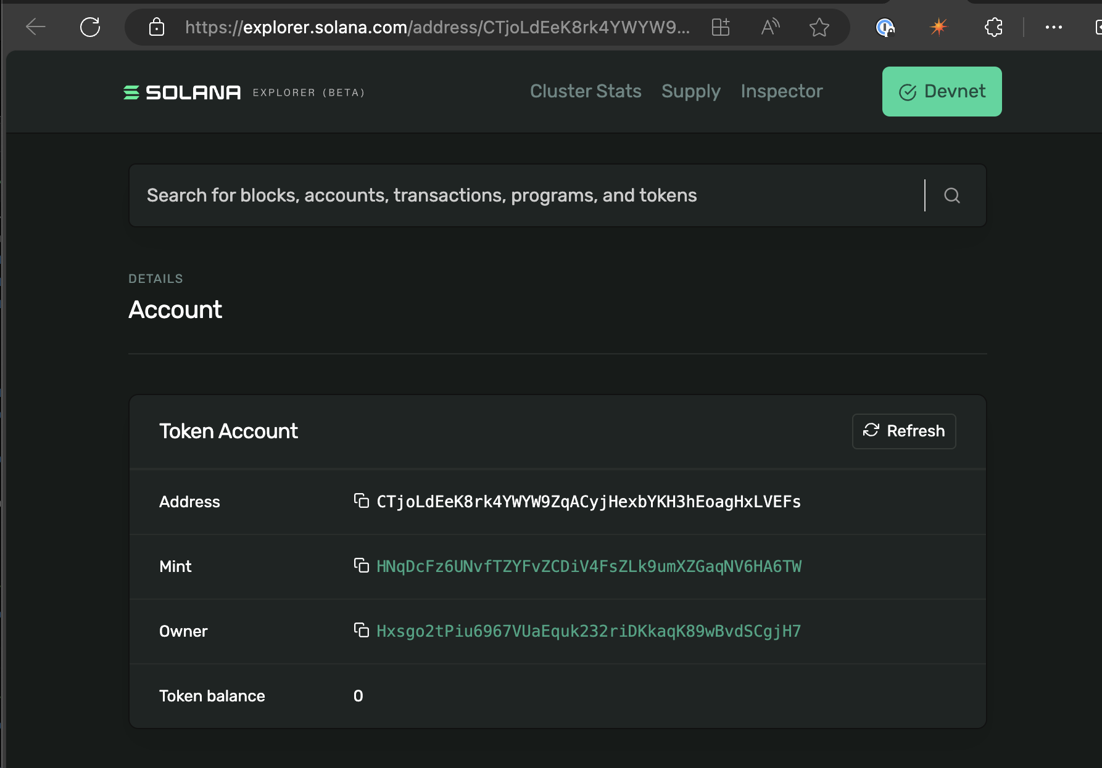
7. Open Solana Explorer and look at the recipient's new associated token account
Who is the owner of the newly created token account?
What is the mint of the newly created token account?

Slide 71
8. Mint tokens!
mint-tokens.ts
import { mintTo } from "@solana/spl-token";
import "dotenv/config";
import {
getExplorerLink,
getKeypairFromEnvironment,
} from "@solana-developers/helpers";
import { Connection, PublicKey, clusterApiUrl } from "@solana/web3.js";
const connection = new Connection(clusterApiUrl("devnet"), "confirmed");
// Our token has two decimal places
const MINOR_UNITS_PER_MAJOR_UNITS = Math.pow(10, 2);
const sender = getKeypairFromEnvironment("SECRET_KEY");
// Substitute in your token mint account from create-token-mint.ts
const tokenMintAccount = new PublicKey(
"HNqDcFz6UNvfTZYFvZCDiV4FsZLk9umXZGaqNV6HA6TW"
);
continued on next slide...
Notes:
Let's mint some tokens.

Slide 72
9. Mint tokens (continued)
mint-tokens.ts
// Subtitute in a recipient token account you just made
const recipientAssociatedTokenAccount = new PublicKey(
"CTjoLdEeK8rk4YWYW9ZqACyjHexbYKH3hEoagHxLVEFs"
);
const transactionSignature = await mintTo(
connection,
sender,
tokenMintAccount,
recipientAssociatedTokenAccount,
sender,
10 * MINOR_UNITS_PER_MAJOR_UNITS
);
const link = getExplorerLink("transaction", transactionSignature, "devnet");
console.log(`✅ Success! Mint Token Transaction: ${link}`);
npx esrun mint-tokens.ts
Notes:
We can mint the tokens directly to any associated token account - this could be our own ATA, or a classmates.

Slide 73
10. Open Solana Explorer
Look at the Token Program Mint to Instruction
What is the updated balance of the recipients Asociated Token Account?

Slide 74
11. Send tokens!
send-spl-tokens.ts
import "dotenv/config";
import {
getExplorerLink,
getKeypairFromEnvironment,
} from "@solana-developers/helpers";
import { Connection, PublicKey, clusterApiUrl } from "@solana/web3.js";
import { getOrCreateAssociatedTokenAccount, transfer } from "@solana/spl-token";
const connection = new Connection(clusterApiUrl("devnet", "confirmed"));
const sender = getKeypairFromEnvironment("SECRET_KEY");
console.log(
`🔑 Loaded our keypair securely, using an env file! Our public key is: ${sender.publicKey.toBase58()}`
);
// Add the recipient public key here
const recipient = new PublicKey("YOUR_RECIPIENT_HERE");
// Subtitute in your token mint account
const tokenMintAccount = new PublicKey("YOUR_TOKEN_MINT_ADDRESS_HERE");
// Our token has two decimal places
const MINOR_UNITS_PER_MAJOR_UNITS = Math.pow(10, 2);
console.log(`💸 Attempting to send 1 token to ${recipient.toBase58()}...`);
continued on next slide...
Notes:
Let's send some tokens. You can any token that you have, to anyone else in the class - you just need to know their wallet address, and the token you want to send.

Slide 75
12. Send tokens (continued)
send-spl-tokens.ts
// Get or create the source and destination token accounts to store this token
const sourceTokenAccount = await getOrCreateAssociatedTokenAccount(
connection,
sender,
tokenMintAccount,
sender.publicKey
);
const destinationTokenAccount = await getOrCreateAssociatedTokenAccount(
connection,
sender,
tokenMintAccount,
recipient
);
// Transfer the tokens
const signature = await transfer(
connection,
sender,
sourceTokenAccount.address,
destinationTokenAccount.address,
sender,
1 * MINOR_UNITS_PER_MAJOR_UNITS
);
const explorerLink = getExplorerLink("transaction", signature, "devnet");
console.log(`✅ Transaction confirmed, explorer link is: ${explorerLink}!`);
npx esrun send-spl-tokens.ts
Notes:
Send the tokens!

Slide 76
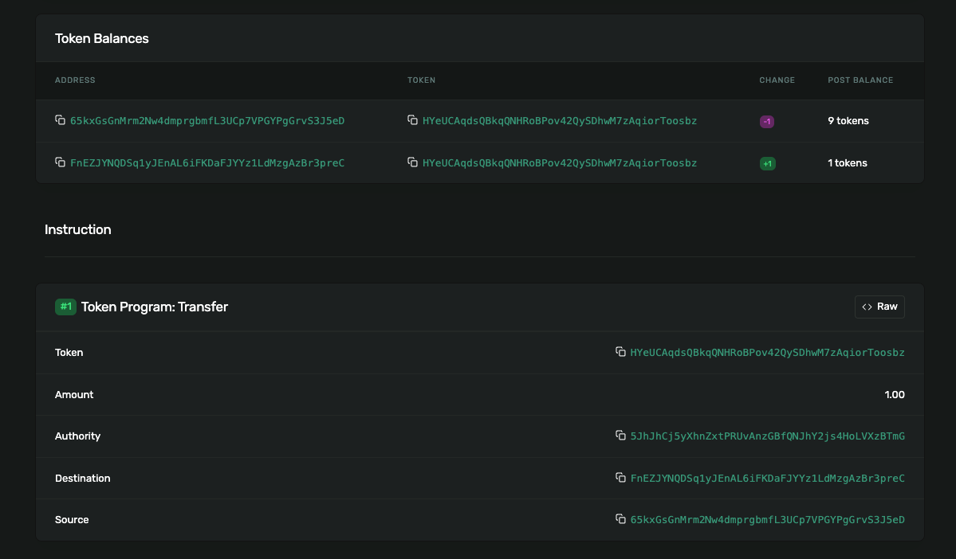
13. Open the transaction in Solana Explorer
What accounts were involved in sending the SPL token?

Slide 77
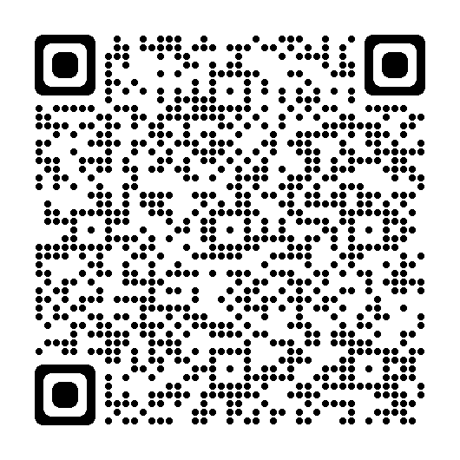
Lesson 4 feedback
Let us know what you think!

Slide 78
LESSON 5: TOKEN
METADATA

Slide 79
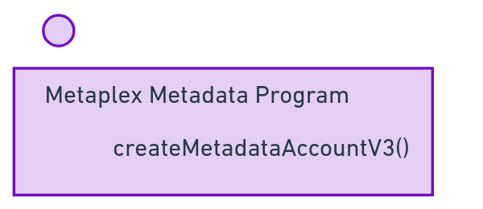
Metaplex adds metadata - additional data, like a name and symbol - for both regular tokens and NFTs.
Let's mint new tokens and transfer them to Bob!
Notes:
A token is uniquely defined by it's mint address
It has a mint authority - someone specified by public key allowed to mint new tokens
It has a freeze authroity - someone specified by public key that can stop new tokens being minted

Slide 80
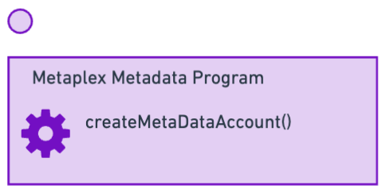
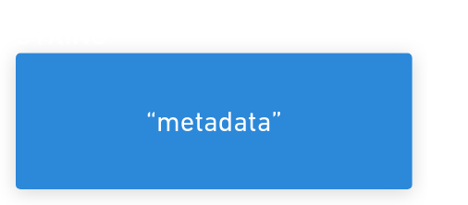
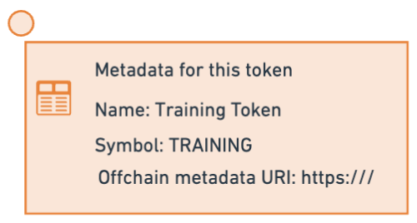
Metaplex adds metadata - additional data, like a name and symbol - for both regular tokens and NFTs.
The metadata is stored in a Solana PDA.
Let's mint new tokens and transfer them to Bob!
Notes:
A token is uniquely defined by it's mint address
It has a mint authority - someone specified by public key allowed to mint new tokens
It has a freeze authroity - someone specified by public key that can stop new tokens being minted

Slide 81
Notes:
A token is uniquely defined by it's mint address
It has a mint authority - someone specified by public key allowed to mint new tokens
It has a freeze authroity - someone specified by public key that can stop new tokens being minted

Slide 82
LAB
CREATE TOKEN METADATA

Slide 83
1. Install Metaplex version 2
npm i "@metaplex-foundation/mpl-token-metadata@2"
Notes:
INSTRUCTOR: there may be warnings
We keep 'solana-program' crate in line with our installed version of the CLI.
solana -V
Jacob mentions you won't need to do this in an upcoming release.
ahash errors: fix it by going to programs/anchor-counter/Cargo.toml:
add
[dependencies]
ahash = "=0.8.4"
In top level Cargo.toml set
[workspace]
resolver = "2"
This also fixes the libc future deprecations warning!
And rename ctx to _ctx
And set a license in package.json

Slide 84
2. Load a keypair and connect
create-token-metadata.ts
// This uses "@metaplex-foundation/mpl-token-metadata@2" to create tokens
import "dotenv/config";
import {
getKeypairFromEnvironment,
getExplorerLink,
} from "@solana-developers/helpers";
import {
Connection,
clusterApiUrl,
PublicKey,
Transaction,
sendAndConfirmTransaction,
} from "@solana/web3.js";
// Yes, createCreate! We're making an instruction for createMetadataV3...
import { createCreateMetadataAccountV3Instruction } from "@metaplex-foundation/mpl-token-metadata";
const user = getKeypairFromEnvironment("SECRET_KEY");
const connection = new Connection(clusterApiUrl("devnet"));
console.log(
`🔑 We've loaded our keypair securely, using an env file! Our public key is: ${user.publicKey.toBase58()}`
);
Continued on next page....
Notes:
Extend the file

Slide 85
3. Set our Metadata
create-token-metadata.ts (continued)
const TOKEN_METADATA_PROGRAM_ID = new PublicKey(
"metaqbxxUerdq28cj1RbAWkYQm3ybzjb6a8bt518x1s"
);
// Subtitute in your token mint account from create-token-mint.ts
const tokenMintAccount = new PublicKey(
"HNqDcFz6UNvfTZYFvZCDiV4FsZLk9umXZGaqNV6HA6TW"
);
const metadataData = {
name: "Solana Training Token",
symbol: "TRAINING",
// Arweave / IPFS / Pinata etc link using metaplex standard for off-chain data
uri: "https://arweave.net/1234",
sellerFeeBasisPoints: 0,
creators: null,
collection: null,
uses: null,
};
Continued on next page....
Notes:
Extend the file

Slide 86
4. Make a PDA to store it
create-token-metadata.ts (continued)
const metadataPDAAndBump = PublicKey.findProgramAddressSync(
[
Buffer.from("metadata"),
TOKEN_METADATA_PROGRAM_ID.toBuffer(),
tokenMintAccount.toBuffer(),
],
TOKEN_METADATA_PROGRAM_ID
);
const metadataPDA = metadataPDAAndBump[0];
const transaction = new Transaction();
const createMetadataAccountInstruction =
createCreateMetadataAccountV3Instruction(
{
metadata: metadataPDA,
mint: tokenMintAccount,
mintAuthority: user.publicKey,
payer: user.publicKey,
updateAuthority: user.publicKey,
},
{
createMetadataAccountArgsV3: {
collectionDetails: null,
data: metadataData,
isMutable: true,
},
}
);
transaction.add(createMetadataAccountInstruction);
Continued on next page....
Notes:
Extend the file

Slide 87
5. Create our Metadata account!
create-token-metadata.ts (continued)
await sendAndConfirmTransaction(
connection,
transaction,
[user]
);
const tokenMintLink = getExplorerLink(
"address",
tokenMintAccount.toString(),
"devnet"
);
console.log(`✅ Look at the token mint again: ${tokenMintLink}!`);
npx esrun create-token-metadata.ts
Notes:
Extend the file

Slide 88
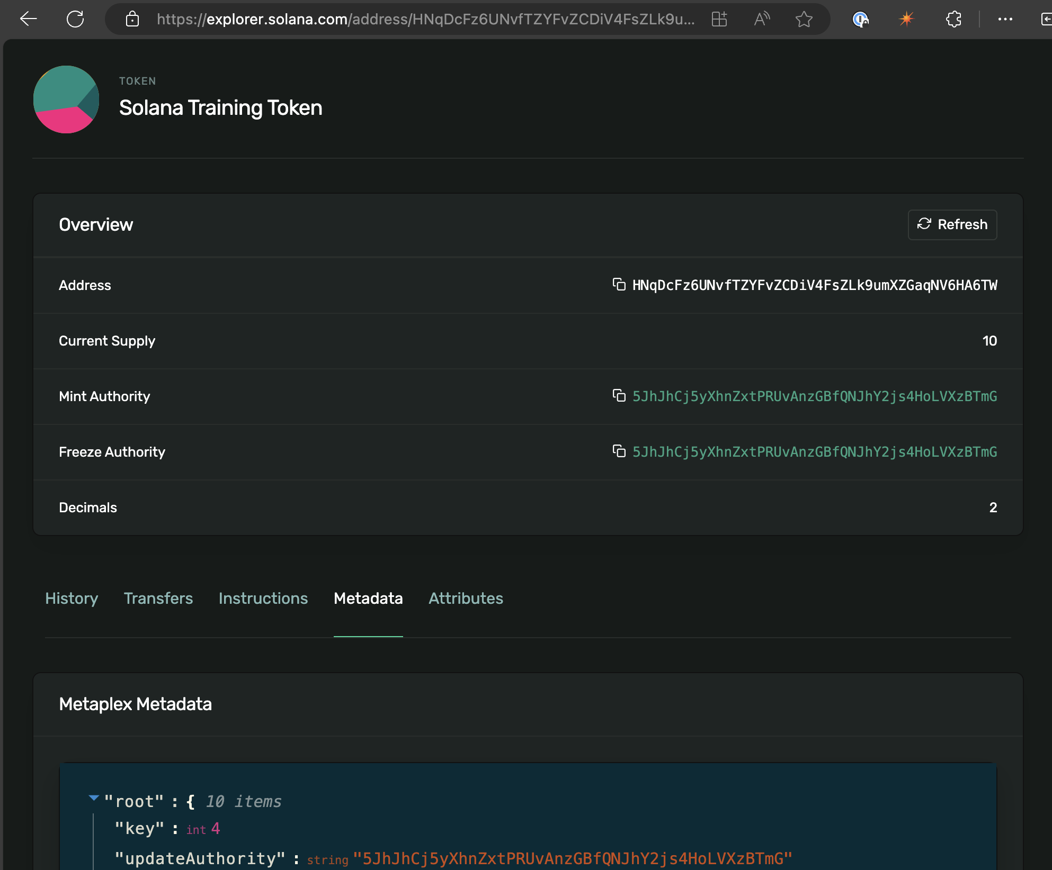
6. Open Solana Explorer
Look at the Token Mint - what changed?
Click the metadata tab of the token mint. What can you see?

Slide 89
Lesson 5 feedback
Let us know what you think!

Slide 90
LESSON 6: INTRO TO
ANCHOR

Slide 91
The most popular way to build onchain apps is using Rust using the Anchor framework.
Notes:
Frameworks for other languages, including TypeScript, Python and Move are coming soon.
These frameworks implement common security checks automatically, and handle common tasks like:
sending incoming instructions to the right instruction handlers
deserialising data from incoming transactions
checking the accounts provided with incoming instructions, for example to check that certain accounts are of a particular type, or are distinct from other accounts.

Slide 92
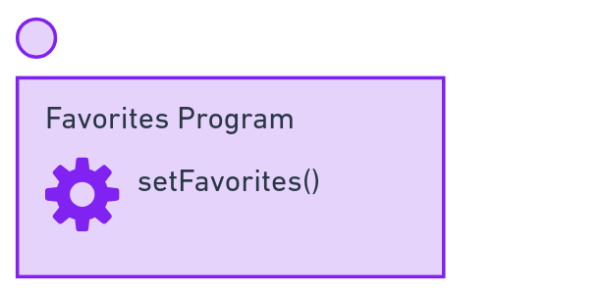
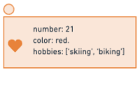
Our first program sets Favorite things using a Program Derived Address to store them.

Slide 93
Rust equivalents of TypeScript concepts
TypeScript | Rust | Notes
Number, BN, BigInt | u8, u16, u32, etc. i8, i16, i32 etc | i means has a +/- Then size in bits.
String | String, str
Array | Array or vec | Syntax is the same, so Vec<str>
Record | Struct
- | Macro | Applied at compile time, to wrap around the next statement and generate code.
import | use | Dependencies are crates in [dependencies] in Cargo.toml
Notes:
If you have VScode, install Rust Analyzer!

Slide 94
LAB
ONCHAIN PROGRAMMING

Slide 95
A minor note on this lab:
The word 'favorites' is spelt differently in British English and American English.
Be consistent in your spelling!
These examples use American English.
Notes:
People have sometimes had trouble in this lab from mixing favourites and favorites

Slide 96
1. Install Solana CLI, Rust and Anchor
Solana CLI beta release
sh -c "$(curl -sSfL https://release.solana.com/beta/install)"
Rust 1.76
curl --proto '=https' --tlsv1.2 -sSf https://sh.rustup.rs | sh
Anchor 0.30
cargo install --git https://github.com/coral-xyz/anchor avm --locked --force
avm install latest
avm use latest
Notes:
INSTRUCTOR: Solana 1.18 is nearly out and includes many fixes (particulaly around ahash) that make it preferable over 1.17
Remember Anchor uses rustc that comes from Solana CLI, not the global rustc
cargo build-sbf --version

Slide 97
2. Make a new anchor project, and run the default tests
anchor init favorites
cd favorites
anchor test
Notes:
INSTRUCTOR: there may be warnings, see next slide.
"these are problems that could happen"

Slide 98
3. Troubleshoot Anchor!
Error | Fix
package `solana-program v1.18.11` cannot be built because it requires rustc 1.75.0 or newer, while the currently active rustc version is 1.72.0-dev | cargo add solana-program@"=1.18.5"
No license field in package.json warning | Open package.json, add "license": "MIT" or "license": "UNLICENSED" depending on preferences
Error: Unable to read keypair file | Add a keypair (just the array of numbers) to ~/.config/solana/id.json solana-keygen new --no-bip39-passphrase
Notes:
Ensure 'anchor test' finishes without errors before moving on.

Slide 99
4. Questions:
Does the anchor project compile without any warnings?
What is the name of the instruction handler?
The program has a ID, which is a pubkey.
Where does the keypair for this exist? Hint: it's in your project.

Slide 100
5. Import Anchor prelude, and tell Anchor what we will store in our PDA
programs/favorites/src/lib.rs
use anchor_lang::prelude::*;
// Our program's address! You don't need to change it.
// This matches the private key in the target/deploy directory
declare_id!("KEEP THE EXISTING PUBLIC KEY");
// Anchor programs always use
#[constant]
pub const ANCHOR_DISCRIMINATOR_SIZE: usize = 8;
continued on next slide...
Notes:
lib.rs is where the action happens
use is like import. The anchor prelude is the most common parts of anchor, we import everything to save us typing the full path.
mod makes a Rust module. the #[program] macro turns that module into a Solana program! This means alll the functions inside are Solana instruction handlers!

Slide 101
6. Make a module for a Solana Program!
programs/favorites/src/lib.rs continued...
// Our Solana program!
#[program]
pub mod favorites {
use super::*;
// Our instruction handler! It sets the user's favorite number and color
pub fn set_favorites(context: Context<SetFavorites>, number: u64, color: String) -> Result<()> {
let user_public_key = context.accounts.user.key();
msg!("Greetings from {}", context.program_id);
msg!(
"User {}'s favorite number is {} and favorite color is: {}",
user_public_key,
number,
color
);
context.accounts.favorites.set_inner(Favorites {
number,
color
});
Ok(())
}
// We can also add a get_favorites instruction to get the user's favorite number and color
}
continued on next slide...
Notes:
Our set_favorites() function takes favorites from a user and saves them to a PDA.

Slide 102
6. Tell Anchor what will go inside our PDA
programs/favorites/src/lib.rs continued...
// What we will put inside the Favorites PDA
#[account]
#[derive(InitSpace)]
pub struct Favorites {
pub number: u64,
#[max_len(50)]
pub color: String
}
continued on next slide...
Notes:
We need to define the structure (like a TypeScript record) for what will be stored inside the Favorites account.

Slide 103
6. Tell Anchor the accounts that must be provided
programs/favorites/src/lib.rs continued...
// When people call the set_favorites instruction, they will need to provide the accounts that will be modifed. This keeps Solana fast!
#[derive(Accounts)]
pub struct SetFavorites<'info> {
#[account(mut)]
pub user: Signer<'info>,
#[account(
init,
payer = user,
space = ANCHOR_DISCRIMINATOR_SIZE + Favorites::INIT_SPACE,
seeds=[b"favorites", user.key().as_ref()],
bump)]
pub favorites: Account<'info, Favorites>,
pub system_program: Program<'info, System>,
}
Done! You have made a solana program
Notes:
Lastly, we need to make another struct for the accounts that will be used by set_favorites() function. Anchor's naming convention is to name the Account struct the same name as the function.

Slide 104
6. Make some tests! First load a user keypair.
cp ../.env .env
Inside tests/favorites.ts, inside the the 'it' block
// Load our wallet
const user = getKeypairFromEnvironment("SECRET_KEY");
await airdropIfRequired(
anchor.getProvider().connection,
user.publicKey,
0.5 * web3.LAMPORTS_PER_SOL,
1 * web3.LAMPORTS_PER_SOL
);
// Here's what we want to write to the blockchain
const favoriteNumber = new anchor.BN(23);
const favoriteColor = "red";
Rename the 'it' block to be it("Writes our favorites to the blockchain" ....
continued on next slide...

Slide 105
6. Write data to the chain for the user
continued...
// Generate the PDA for the user's favorites
const favoritesPdaAndBump = web3.PublicKey.findProgramAddressSync(
[Buffer.from("favorites"), user.publicKey.toBuffer()],
program.programId
);
const favoritesPda = favoritesPdaAndBump[0];
// Make a transaction to write to the blockchain
let tx: string | null = null;
try {
tx = await program.methods
// Call the set_favorites instruction handler
.setFavorites(favoriteNumber, favoriteColor)
.accounts({
user: user.publicKey,
favorites: favoritesPda,
})
// Sign the transaction
.signers([user])
// Send the transaction to the cluster or RPC
.rpc();
} catch (thrownObject) {
// Let's properly log the error
// so we can see the program involed
// and (for well known programs) the full log message
const rawError = thrownObject as Error;
throw new Error(getCustomErrorMessage(systemProgramErrors, rawError.message));
}
continued on next slide...

Slide 106
6. Check the data was written!
continued...
const dataFromPda = await program.account.favorites.fetch(favoritesPda);
// And make sure it matches!
assert.equal(dataFromPda.color, favoriteColor);
// A little extra work to make sure the BNs are equal
assert.equal(dataFromPda.number.toString(), favoriteNumber.toString());
anchor test

Slide 107
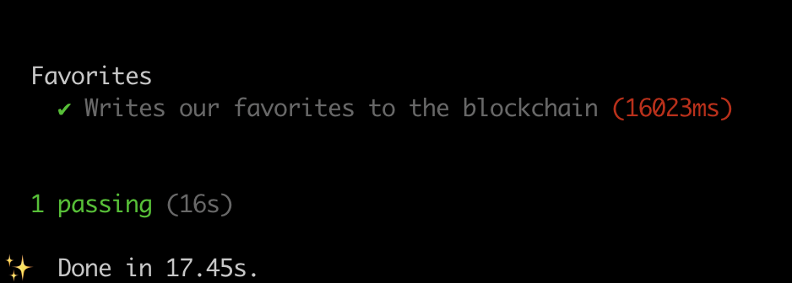
6. Run the tests with
anchor test
You are now writing data to Solana!

Slide 108
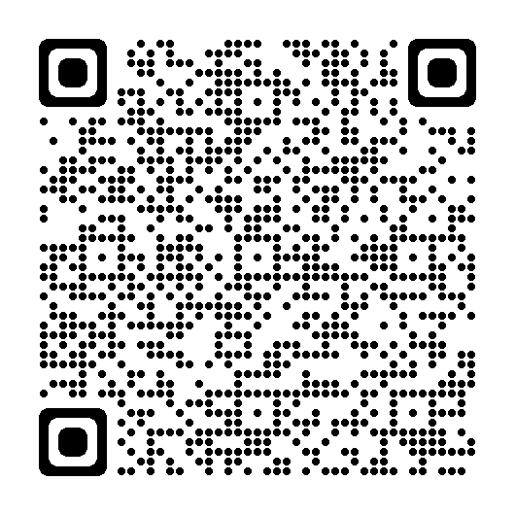
Lesson 6 feedback
Let us know what you think!

Slide 109
LESSON 7: USING ANCHOR WITH
TOKENS

Slide 110
Our next program allows a user to offer an amount of one token in exchange for an amount of another token.

Slide 111
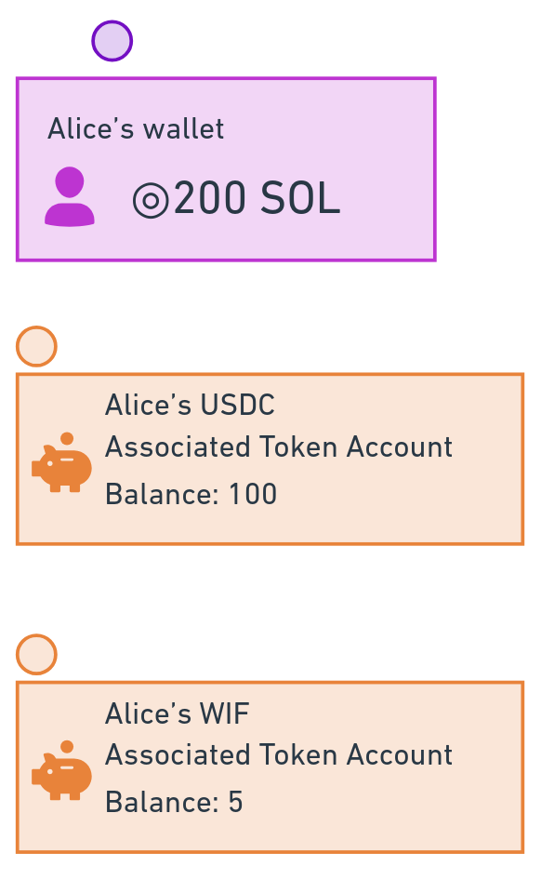
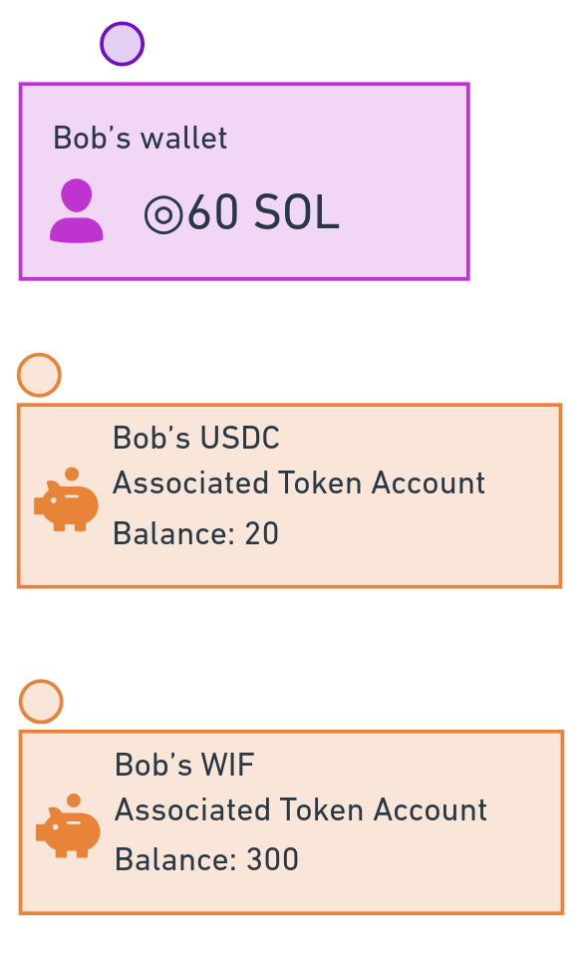
Alice has lots of USDC Bob has lots of WIF
Notes:
For example, Alice wants 100 WIF, and is offering to swap 10 USDC.
Without our program, the users would have to swap with each other manually.

Slide 112
Alice wants 100 WIF and is offering 10 USDC. Bob wants to take that offer. How can we ensure Alice and Bob don't run away with each other's tokens?
Notes:
What if Bob promised to send Alice 100 WIF but took the 10 USDC instead and ran? Or what if Alice was dishonest, received the 10 USDC, and decided not to send the 100 WIF?

Slide 113
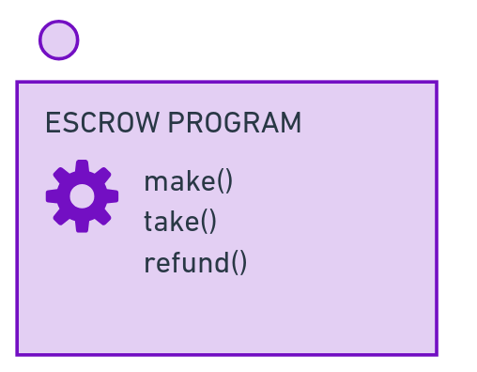
This is solved with an Escrow program!

Slide 114
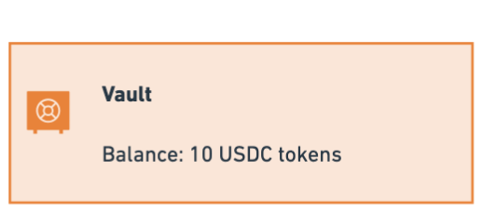
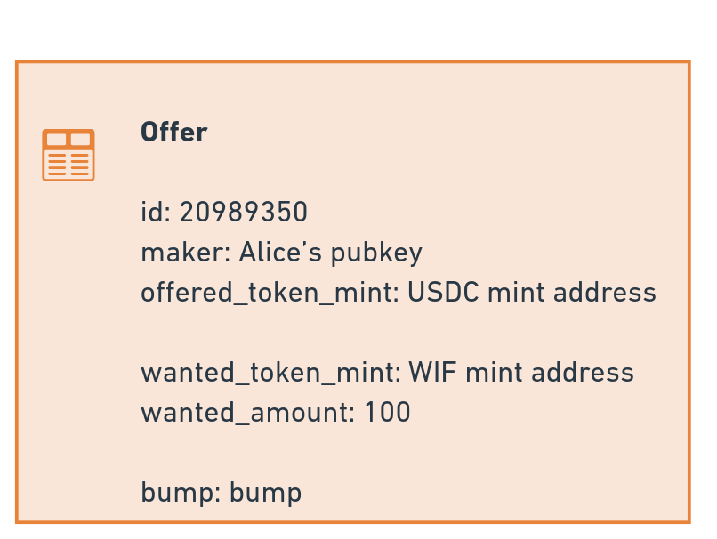
Our Escrow program will hold the funds provided by Alice, and store details of her offer.

Slide 115
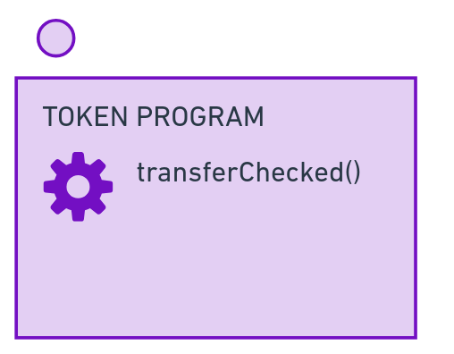
We'll also the Token program to do the token transfers!

Slide 116
LAB
ANCHOR AND TOKENS

Slide 117
1. Make a new anchor project, and run the default tests.
anchor init escrow
cd escrow
anchor test
Notes:
Make sure everything works out of the box before continuing,

Slide 118
2. Create our make_offer() function!
Add to the top of programs/escrow/src/lib.rs
use anchor_spl::{
associated_token::AssociatedToken,
token_interface::{transfer_checked, Mint, TokenAccount, TokenInterface, TransferChecked},
};
const ANCHOR_DISCRIMINATOR: usize = 8;
programs/favorites/src/lib.rs (replace initialize() )
pub fn make_offer(
ctx: Context<Make>,
id: u64,
offered_amount: u64,
wanted_amount: u64,
) -> Result<()> {
move_offered_tokens_to_vault(&ctx, offered_amount)?;
save_offer(ctx, id, wanted_amount)
}
continued on next slide...
Notes:
Just under where we use the Anchor prelude, add Anchor SPL! Let's make a constant for ANCHOR_DISCRIMINATOR too.
Now replace initialize() with make_offer()! This is the function that user's will call to offer some tokens in exchange for other tokens!

Slide 119
4. Add move_offered_tokens_to_vault()
programs/favorites/src/lib.rs
pub fn move_offered_tokens_to_vault(ctx: &Context<Make>, offered_amount: u64) -> Result<()> {
let transfer_accounts = TransferChecked {
from: ctx.accounts.maker_offered_token_account.to_account_info(),
mint: ctx.accounts.offered_token_mint.to_account_info(),
to: ctx.accounts.vault.to_account_info(),
authority: ctx.accounts.maker.to_account_info(),
};
let cpi_ctx = CpiContext::new(
ctx.accounts.token_program.to_account_info(),
transfer_accounts,
);
transfer_checked(
cpi_ctx,
offered_amount,
ctx.accounts.offered_token_mint.decimals,
)
}
continued on next slide...
Notes:
A CPI is a 'cross-program invocation'—this means our Anchor program is running another Solana program to do something. In this case, we are using the Token Program's transfer function to send Alice's tokens into the vault.

Slide 120
4. Add save_offer() and the Offer struct
programs/favorites/src/lib.rs
pub fn save_offer(ctx: Context<Make>, id: u64, wanted_amount: u64) -> Result<()> {
ctx.accounts.offer.set_inner(Offer {
id,
maker: ctx.accounts.maker.key(),
offered_token_mint: ctx.accounts.offered_token_mint.key(),
wanted_token_mint: ctx.accounts.wanted_token_mint.key(),
wanted_amount,
bump: ctx.bumps.offer,
});
Ok(())
}
continued on next slide...
#[account]
#[derive(InitSpace)]
pub struct Offer {
pub id: u64,
pub maker: Pubkey,
pub offered_token_mint: Pubkey,
pub wanted_token_mint: Pubkey,
pub wanted_amount: u64,
pub bump: u8,
}
Notes:
We'll also make a PDA to store details of this offer.

Slide 121
6. Tell Anchor the accounts we expect!
Notes:
This seems like a lot of code, but it's literally every item that was on the diagram earlier!

Slide 122
6. Run the tests with
anchor test
You are now writing data to Solana!

Slide 123
Lesson 6 feedback
Let us know what you think!

Slide 124

THANKS!

